Slide 1
SEO

Slide 2
Search engines VS Search browsers

Slide 3
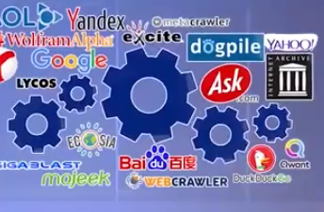

Slide 4
Google is consider most favorite around world.

Slide 5
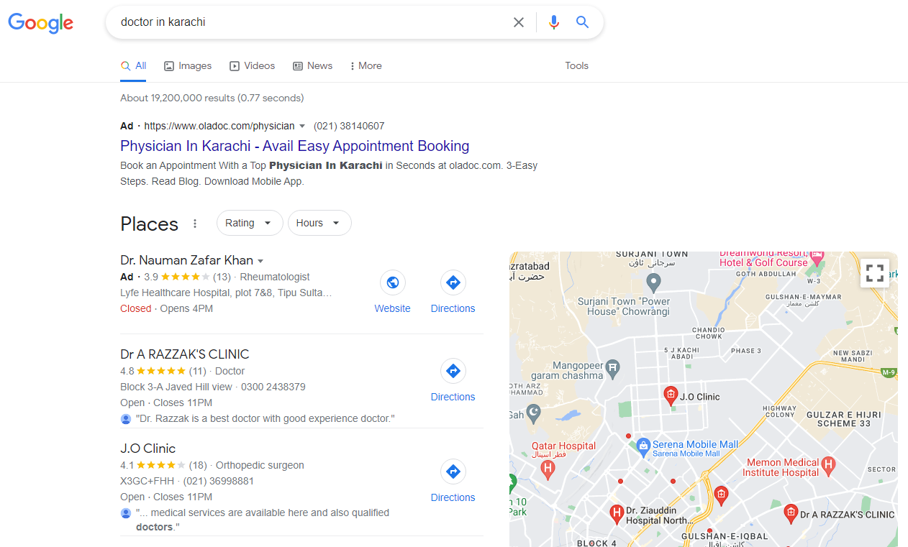
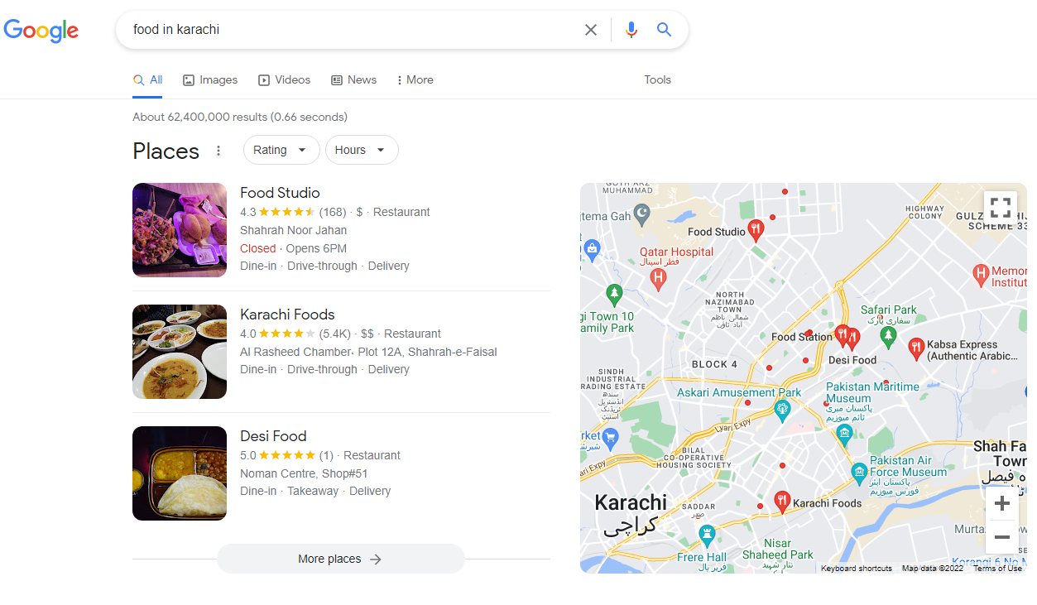
What is search?
Need Want

Slide 6
Intent
This is called intent (maqsad)… for e.g apko bhook lagi restaurant ka search kara and tabiyat kharab hoi to doctor ka search kara…

Slide 7
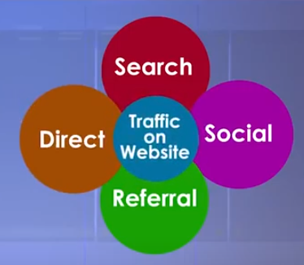
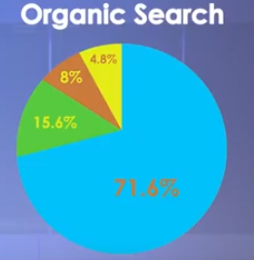
How people come to website
Search is most important.

Slide 8
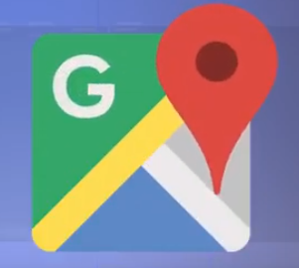

Search Engine
There are different types of search engine for e.g. if you want to go somewhere you use google maps o if you want to watch any video you search on YouTube.

Slide 9
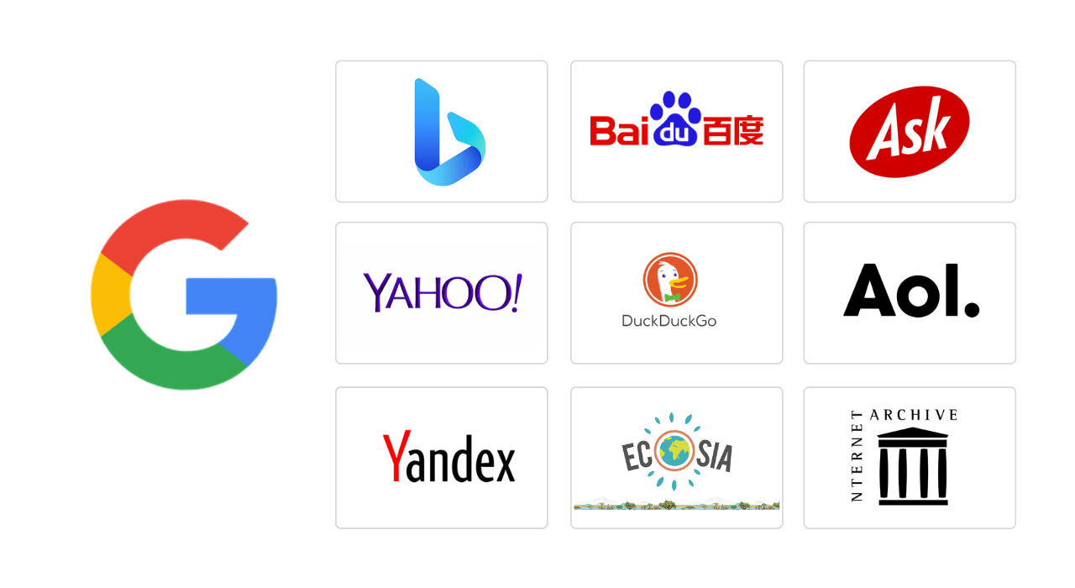
General Search Engines

Slide 10
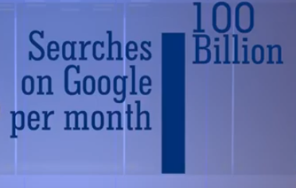
Google
Google is no.1 around the world
So there are 100 billion opportunity to rank for your content.

Slide 11

BING
Microsoft search engine
Convert MSN to Bing
Lot’s of software's search through Bing for e.g. MS word, MS ppt, etc.

Slide 12
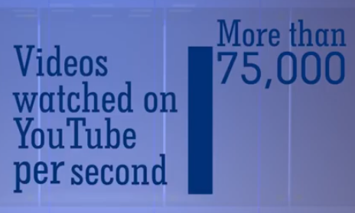
YOUTUBE
Second largest search engine

Slide 13

QUORA
Question & Answer website.

Slide 14
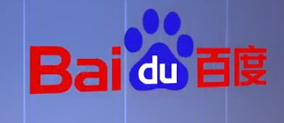
Regional Search Engine
China ban google so they create there own search engine.

Slide 15

INTERNET ARCHIVE
You can check old model of website

Slide 16

DUCK DUCK GO
Privacy conscious search engine means this search engine never use your identity.
Baki search engines apki habit dekh k apko ads dekhaty hein pr duck duck go nhi krta aysa…

Slide 17
How Google Search Works?
When you search on google so google have millions of keyword that matches your search.
For e.g. search Karachi to Lahore then Karachi to Lahore Flights.

Slide 18
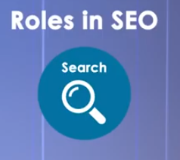
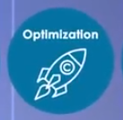
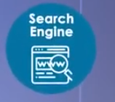
Roles of SEO

Slide 19
OPTIMIZATION
Make your website according to google/search engine is called Optimization.
For e.g. jo google dhoondh k lana cha raha hai who apki website mein mojood ho.

Slide 20
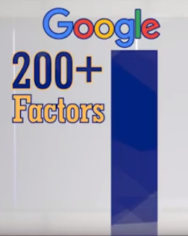
What are SEO Ranking Factors
Google 200+ factors ko dekh k ye decide krta haai k apka page kahan rank krna haai one, two, etc.
Google apni information nhi btata k kaisay rank krta haai agr aysa kray ga to sb log hi rank krwalein.

Slide 21
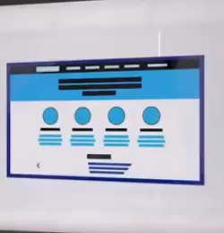
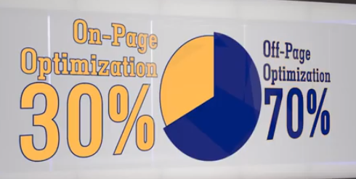
On-page ranking factor/Optimization vs. Off-page ranking factor/Optimization
On-page Content Image Title Layout | Off-page Link building

Slide 22
Outbound Link / Marketing
Zabardasti k ads.
Newspaper ads (for e.g. for more news go to this page)
Tv ads
For eg: pori family apny ghr mein beth k tv dekh rahi haai or property ka ad dikha ja raha haai baar baar.

Slide 23
Inbound Link / Marketing
Jo users cha rahy wesa ad dikhana.

Slide 24
Keywords
Jo bhi ap google pe likh k search kr rahy hein woh sb different keywords hein.

Slide 25
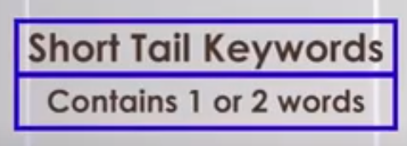
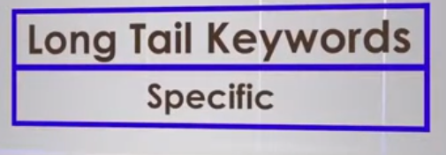
Types of Keywords
For e.g. mobile phone ab hamein ye
pata nhi chal raha k ye mobile phone
kharidna cha raha, beechna cha raha
ya phr usky specs dekhna cha raha.
Short tail search zyada hoty hein but
meaning nhi hoti.
Also known as broad keyword
More than 2 keywords long tail also known
as specific keywords because
they make sense
For e.g buy iphone 12 in karachi

Slide 26
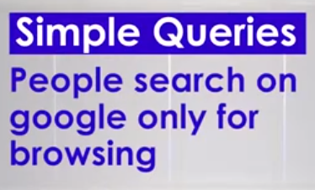
For e.g top 10 mobile phone in 2022

Slide 27
Google Ads Account for Keyword Planner Tool

